Slide 1
AAS_CH7 Extension

Slide 2
Small World Networks
Real world networks are too large
Researchers study and created 3 common models
Examples of small-worlds
Road maps
Food chains
Power grids

Slide 3
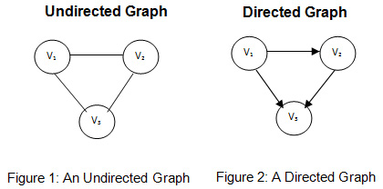
Limitations
All randomly generated models are undirected
Lack of direction
Example: world wide web / hyperlinks

Slide 4
Erdos-Renyi Model (random)
Aka Random Graph Model - 2 variants
G(n,p)
G(n,m)
Limitations
Aren’t random
Small clustering coefficent

Slide 5
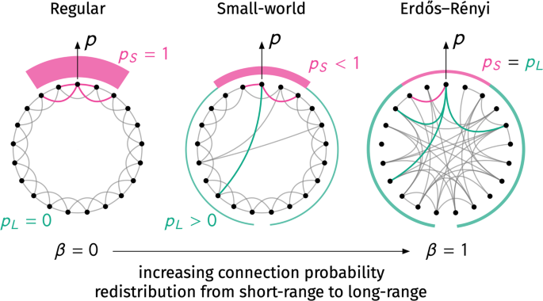

Slide 6
Watts-Strogatz Model (random)
High clustering coefficient and short average path
Randomness through rewiring, no loops/duplications
Limitation
Doesn’t follow power-law: f(x) = C(1/x)α
Fixed number of nodes

Slide 7
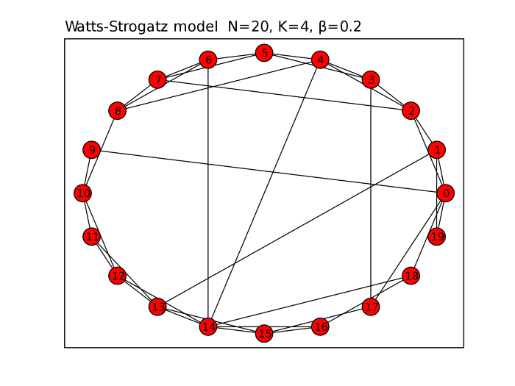

Slide 8
Barabasi-Albert Model
Aforementioned models are limited
Real world networks are growing
New nodes like high degree nodes
Start with m0 nodes and some links
Add node that has m<m0 links
Preferential attachment

